Slide 1

Social Science Research Design and Statistics, 2/e
Alfred P. Rovai, Jason D. Baker, and Michael K. Ponton
Entering Data Manually
PowerPoint Prepared by
Alfred P. Rovai
IBM® SPSS® Screen Prints Courtesy of International Business Machines Corporation,
© International Business Machines Corporation.

Slide 2
Entering Data Manually
Enter data directly in the Data Editor using Data View by highlighting a cell and entering a data value.
The Data Editor creates a new variable and assigns a variable name (e.g., var00001) if one enters a value in a blank column.
  Variable names can be changed in either Data View or Variable View by highlighting the variable name.

Slide 3
Entering Data Manually
You are presented with this SPSS Welcome Dialog upon launching SPSS Statistics 22. To enter data manually in a blank dataset select New Dataset in the New Files: box and then click OK.

Slide 4
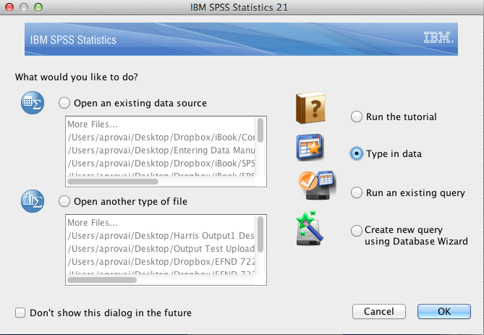
Entering Data Manually
If you have an earlier version of SPSS you will see a somewhat different Welcome dialog. Shown is the Welcome dialog for IBM SPSS Statistics 21. To enter data manually in a blank dataset select the Type in data radio button and click OK.

Slide 5
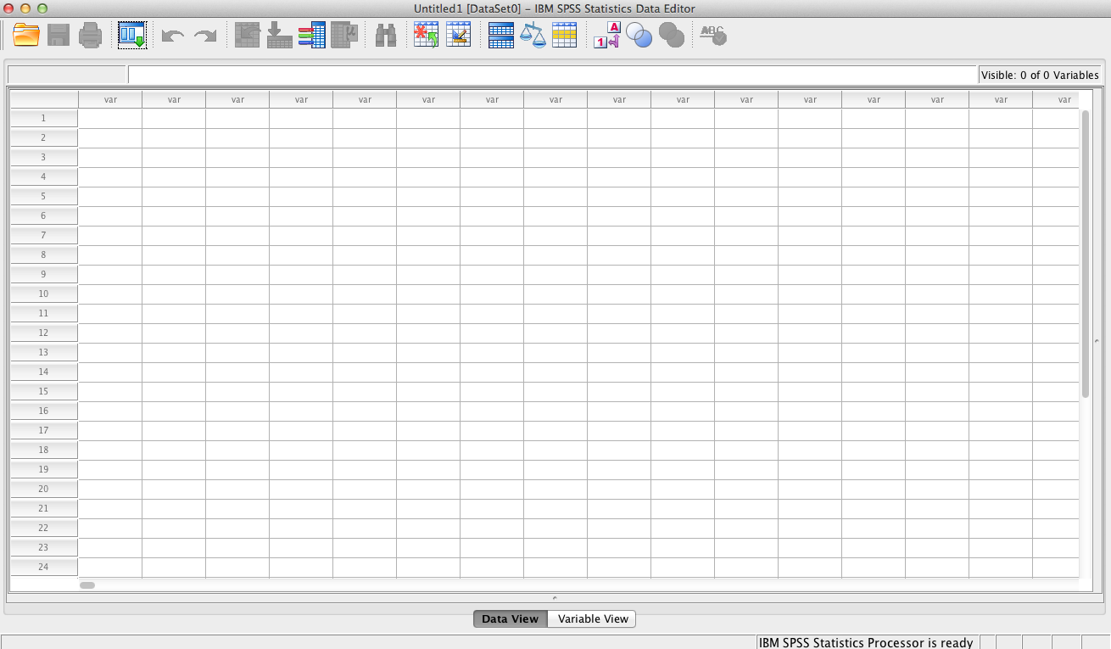
Entering Data Manually
You are now presented with a blank Data Editor.
The paradigm used by SPSS is very similar to that
used by major spreadsheet programs, like
Microsoft Excel®. Rows represent cases (i.e.,
research participants or other units of analysis)
and columns represent variables. Select a cell
and type in the appropriate value. Variable names
can be up to 64 bytes long, and the first character
must be a letter or one of the characters @, #, or $.
Data can be numerical or text (string) values.

Slide 6
Entering Data Manually
One must first organize one’s data before one can enter data manually using the SPSS Data Editor. It is useful to distinguish between independent and dependent data and to determine the scale of measurement for each variable prior to data entry.

Slide 7
Independent Data
Data are independent when data for different cases do not depend on each other. For example, if one’s sample consists of 15 students divided into two groups (Treatment Group and Control Group), the resultant data are independent because each student’s group does not depend on another student’s group, assuming random assignment to groups. Consequently, one creates a variable “group” and enters an appropriate numerical designation to represent each group, e.g., 1 = Treatment Group and 2 = Control Group. Each case is then coded as 1 or 2 for the “group” variable. The result is a nominal scale variable.

Slide 8
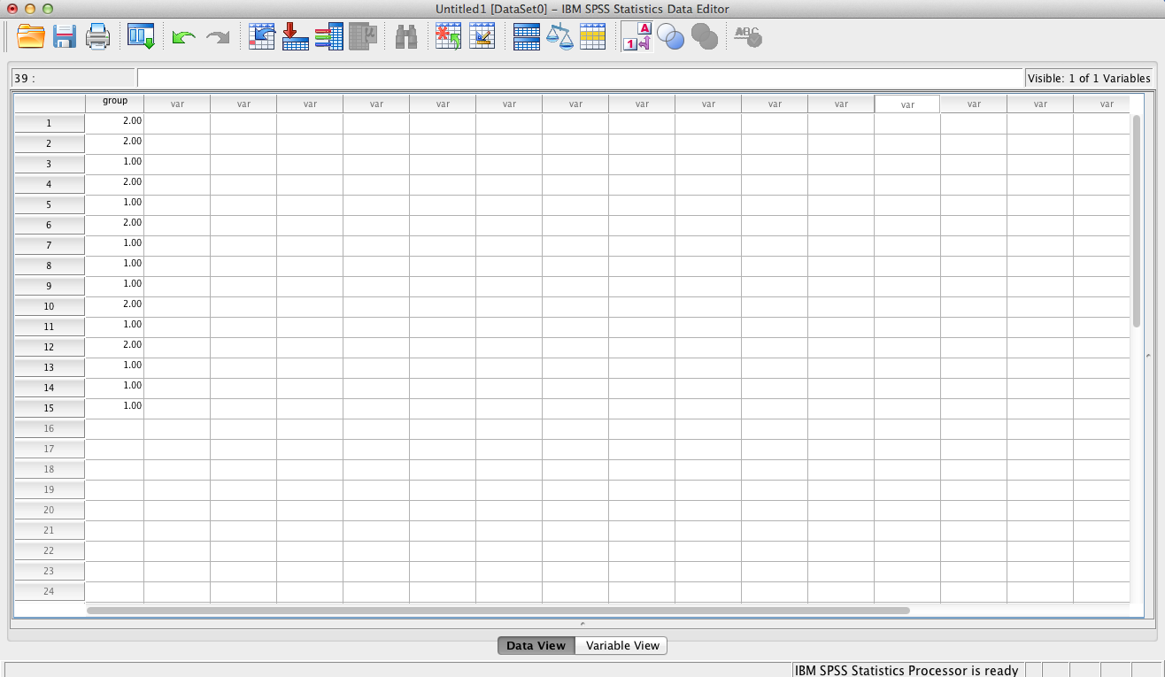
One enters the value for each case to represent the
group to which the case is assigned. Simply select the desired cell
and enter 1 or 2. For example, cases #1 and #2
are assigned to group #2 (Control Group) so one
enters 2 for these two cases in the “group” variable column.
Note that SPSS defaults to displaying two decimal places.
To modify the properties of this variable one selects
Variable View at the bottom of the window.

Slide 9
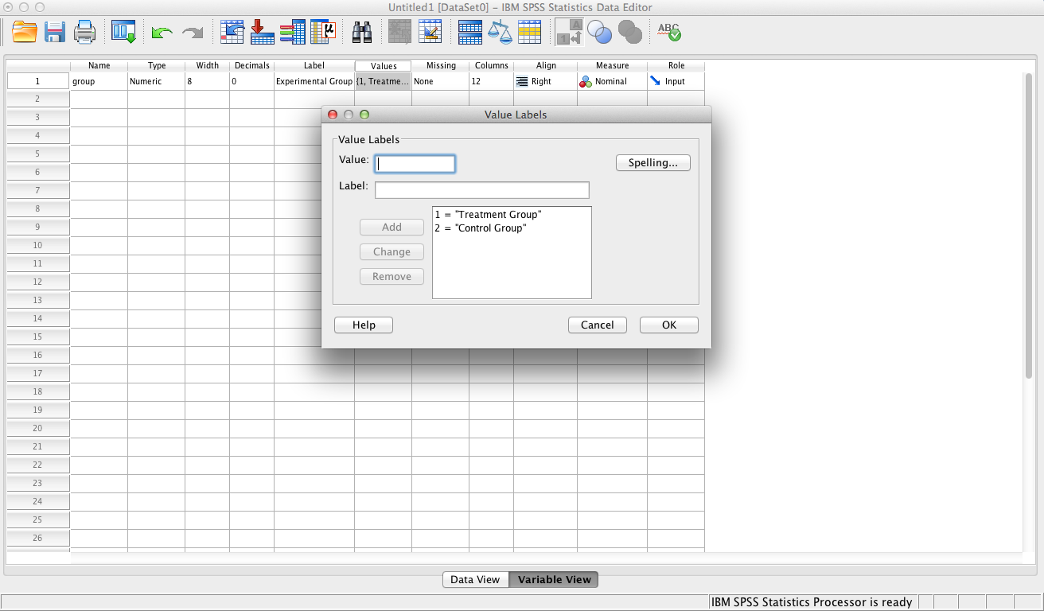
Using Variable View, one can change the Decimals field from 2 to 0. One can also enter a descriptive Label for the variable in the Label field that will be displayed in SPSS output, e.g., Treatment Group instead of 1. Entering value labels in the Values field as shown above will display a descriptive label for each group in SPSS output. Finally, one can identify the scale of measurement (e.g., nominal for this categorical variable) in the Measure field.

Slide 10
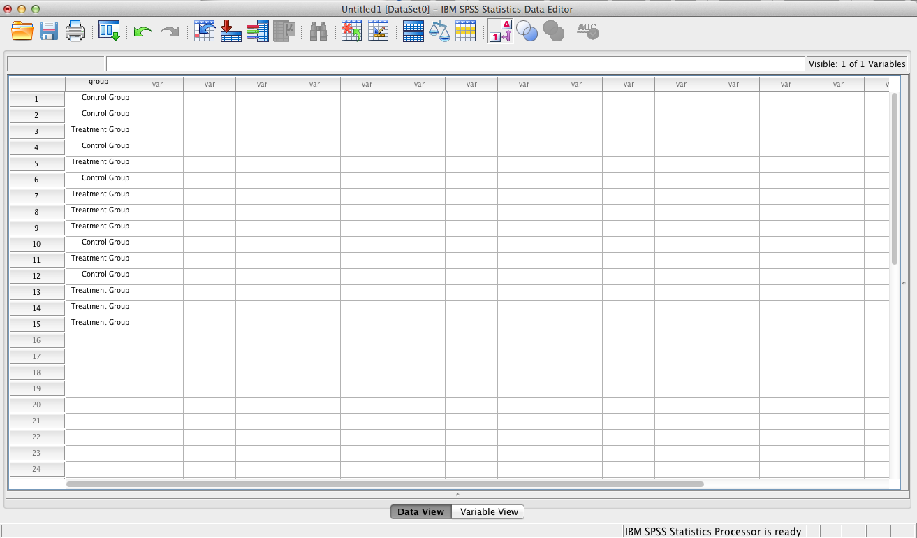
Return to Data View by clicking the Data View tab at the bottom of the window. Clicking the Values Label icon at the top of this window reveals the following display. Clicking the Value Labels repeatedly toggles between displaying value labels (when defined) and numerical data (i.e., 1 and 2).

Slide 11
Dependent Data
Data are dependent when data for different cases (e.g., research participants or subjects) depend on each other or each case is measured multiple times. For example, if one’s sample consists of a group of students and one measures each student twice on some scale or instrument (e.g., pretest and posttest), the resultant data are dependent. Consequently, one creates two variables “pretest” and “posttest” and enters the appropriate data for each case. Both variables are interval scale. In Variable View one identifies these variables as Scale in the Measure field (note: scale is used for both interval and ratio scales of measurement).

Slide 12
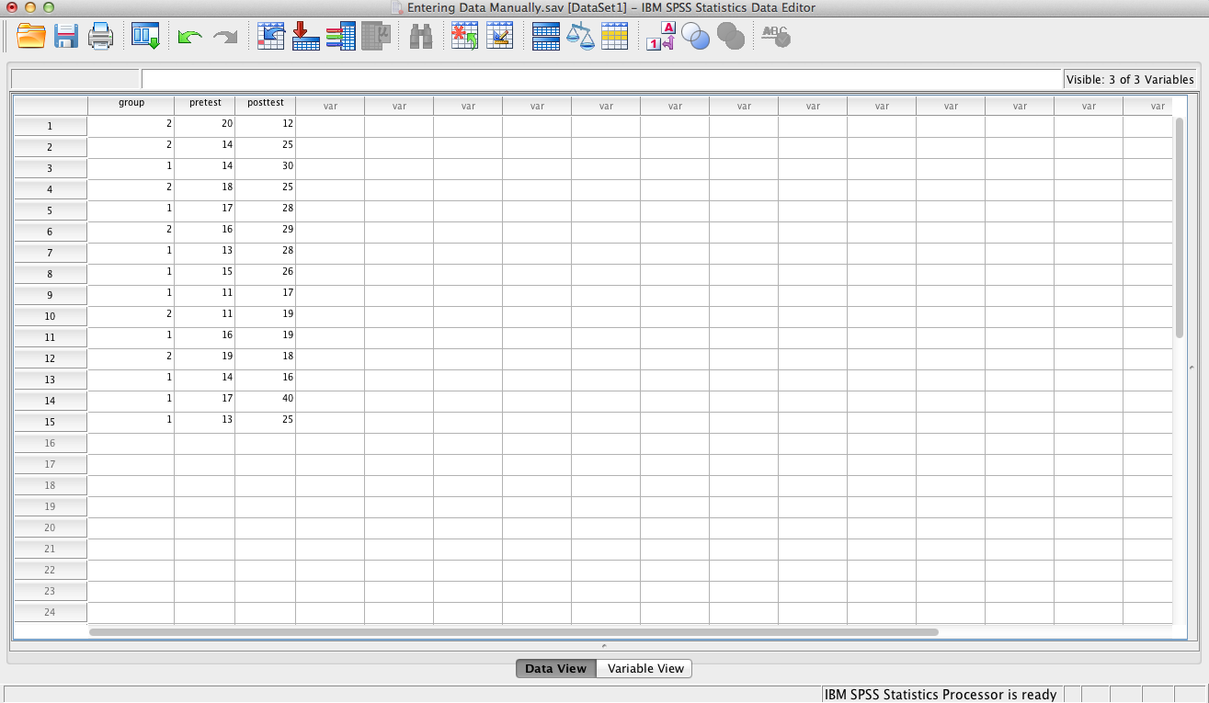
Data View will appear as shown here once the new
variables are added. The Decimals property of the two
new variables were changed from 2 (default) to 0
in Variable View. To display the Value Labels for the
Variable “group,” click on the Values Label icon.

Slide 13
End of Presentation

